Slide 1

Cloud Computing and Distributed Systems
Session-3 (Week-4)
Mayank Taneja,
Teaching Assistant

Slide 2
Q. 1 Which of the following is not the property for quorums in a coterie ?
A. Intersection property
B. Minimality property
C. Total ordered set property
D. Both Intersection and Minimality property

Slide 3
A coterie C is defined as a set of sets, where each set g ∈C is called a quorum.
The following properties hold for quorums in a coterie:
Intersection property: For every quorum g, h ∈ C, g ∩ h ≠ ∅.
For example, sets {1,2,3}, {2,5,7} and {5,7,9} cannot be quorums in a coterie, because first and third sets do not have a common element.
Minimality property: There should be no quorums g, h in coterie C such that g ⊇ h i.e g is superset of h.
For example, sets {1,2,3} and {1,3} cannot be quorums in a coterie because the first set is a superset of the second.

Slide 4
Q. 2 Which event is concurrent with the vector clock (3, 8, 4)?
A. (5, 10, 5)
B. (2, 6, 2)
C. (2, 8, 5)
D. (6, 8, 4)

Slide 5
Answer C) (2,8,5)
Explanation: Two events VT1 and VT2 are concurrent
iff
NOT (VT1 ≤ VT2) AND NOT (VT2 ≤ VT1)
We denote this as VT2 ||| VT1
If we do an element-by element comparison:
(2, 8, 5) is neither ≥ nor ≤ to (3, 8, 4)
2 < 3, 8 = 8, 5 > 4.

Slide 6
Q. 3 A client gets a timestamp of 5:12:30.500 from a time server. The elapsed time
between the request and response was 40 msec (0.040 sec). The current time on
the client is 5:12:30.520. Using Cristian’s algorithm i.e. server time + 1⁄2(elapsed
time), what is the time set on the client?
A. 5:12:30.520
B. 5:12:30.510
C. 5:12:30.490
D. 5:12:30.480

Slide 7
Answer: A) 5:12:30.520
Explanation: Cristian’s algorithm sets the time to:
server time + 1⁄2(elapsed time)
= 5:12:30.500 + 0.040/2
= 5:12:30.500 + 0.020
= 5:12:30.520

Slide 8
Q. 4 A client's clock reads 4:30:00. The server's clock reads 4:10:00 when they
synchronize using the Berkeley algorithm. Assume message delays are negligible.
What is the time at the client after synchronization?
A. 4:10:00
B. 7:30:00
C. 4:15:00
D. 4:20:00

Slide 9
Answer: D) 4:20:00
Explanation:
The Berkeley algorithm averages clocks among the entire group. In this case, the
group has two members: the client and the server. The average of the two clocks is
(4:30:00 + 4:10:00)/2 = 4:20. Both the client and server will be set to 4:20.

Slide 10
Q. 5 Suppose there are two events a and b, having Lamport Timestamps of 1 and 3 respectively. Can we say that event a occurred before event b?
A. Yes
B. No

Slide 11
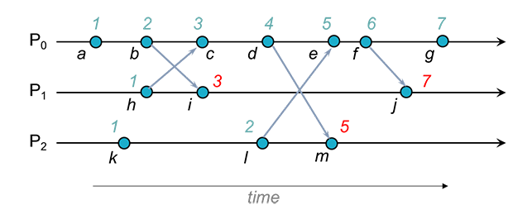
Answer: No
With Lamport timestamps, we are assured that two causally-related events will have timestamps that reflect the order of events.
For example, event h happened before event m in the Lamport causal sense.
However, just by looking at timestamps we cannot conclude that there is a causal happened-before relation.
For instance, because the timestamp for k (1) is less than the timestamp for i (3) does not mean that k happened before i.
Those events happen to be concurrent but we cannot discern that by looking at Lamport timestamps.

Slide 12
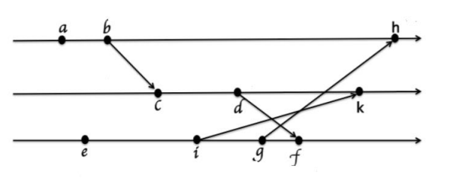
Q. 6 For the given event diagram, identify the correct events with vector clocks. Assume that the vector elements are all set to zero at the beginning.
A. a: (2, 2, 4), b: (0, 0, 3), c: (3, 0, 3), d: (0, 0, 2), e: (2, 3, 2), f: (1, 0, 0), g: (2, 0,0), h: (2, 1, 0), i: (2, 2, 0), k: (0, 0, 1)
B. a: (2, 2, 0), b: (0, 0, 1), c: (2, 2, 4), d: (1, 0, 0), e: (2, 0, 0), f: (2, 1, 0), g: (0, 0,3), h: (3, 0, 3), i: (0, 0, 2), k: (2, 3, 2)
C. a: (1, 0, 0), b: (2, 0, 0), c: (2, 1, 0), d: (2, 2, 0), e: (0, 0, 1), f: (2, 2, 4), g: (0, 0,3), h: (3, 0, 3), i: (0, 0, 2), k: (2, 3, 2)
D. a: (2, 1, 0), b: (2, 2, 0), c: (0, 0, 1), d: (2, 2, 4), e: (0, 0, 3), f: (1, 0, 0), g: (2, 0,0), h: (3, 0, 3), i: (0, 0, 2), k: (2, 3, 2)

Slide 13
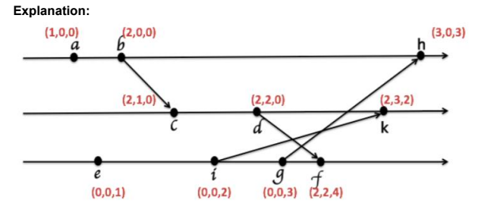
Answer: C) a: (1, 0, 0), b: (2, 0, 0), c: (2, 1, 0), d: (2, 2, 0), e: (0, 0, 1), f: (2, 2, 4), g:
(0, 0, 3), h: (3, 0, 3), i: (0, 0, 2), k: (2, 3, 2)

Slide 14
Q. 7 True or False ?
The Chandy-Lamport algorithm uses a control message, called a marker whose role in a FIFO system is to separate messages in the channels.
A. True
B. False

Slide 15
Answer: True
The Chandy-Lamport algorithm uses a control message, called a marker whose role in a FIFO system is to separate messages in the channels.
After a site has recorded its snapshot, it sends a marker, along all of its outgoing channels before sending out any more messages.
A marker separates the messages in the channel into those to be included in the snapshot from those not to be recorded in the snapshot.
A process must record its snapshot no later than when it receives a marker on any of its incoming channels.

Slide 16
Q. 8 True or False ?
DTP (Datacenter Time Protocol) uses the network layer of network devices to
implement a decentralized clock synchronization protocol.
A. True
B. False

Slide 17
Answer: B) False
Explanation: DTP (Datacenter Time Protocol) uses the physical layer of network
devices to implement a decentralized clock synchronization protocol.

Slide 18
Q. 9 Consider the following statements related to the Ricart-Agrawala algorithm:
Statement 1: The Ricart-Agrawala algorithm assumes the communication channels are FIFO. The algorithm uses two types of messages: REQUEST and REPLY.
Statement 2: A process sends a REQUEST message to all other processes to request their permission to enter the critical section. A process sends a REPLY message to a process to give its permission to that process.
A. Only statement 1 is true
B. Only statement 2 is true
C. Both statements are true
D. Both statements are false

Slide 19
Answer: C) Both statements are true

Slide 20
Q. 10 ___________________ is a Google’s system for locking and used underneath Google’s systems like BigTable, Megastore, etc.
A. Paxos
B. Google’s Chubby
C. Cassandra
D. Microsoft Azure

Slide 21
Answer: B) Google’s Chubby

